Slide 1
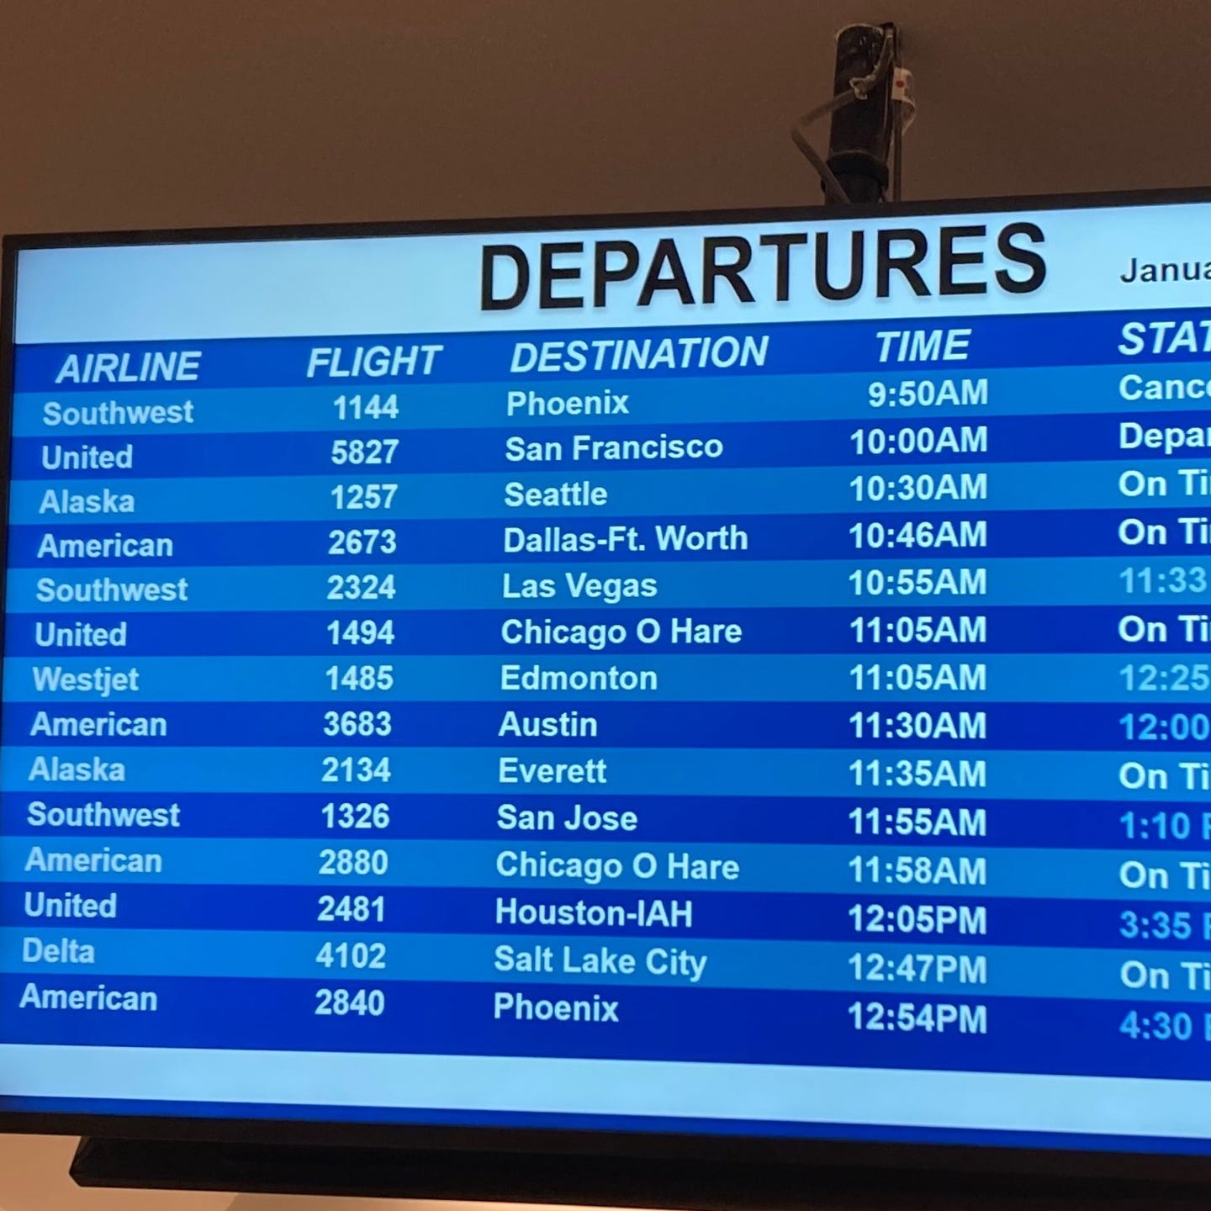
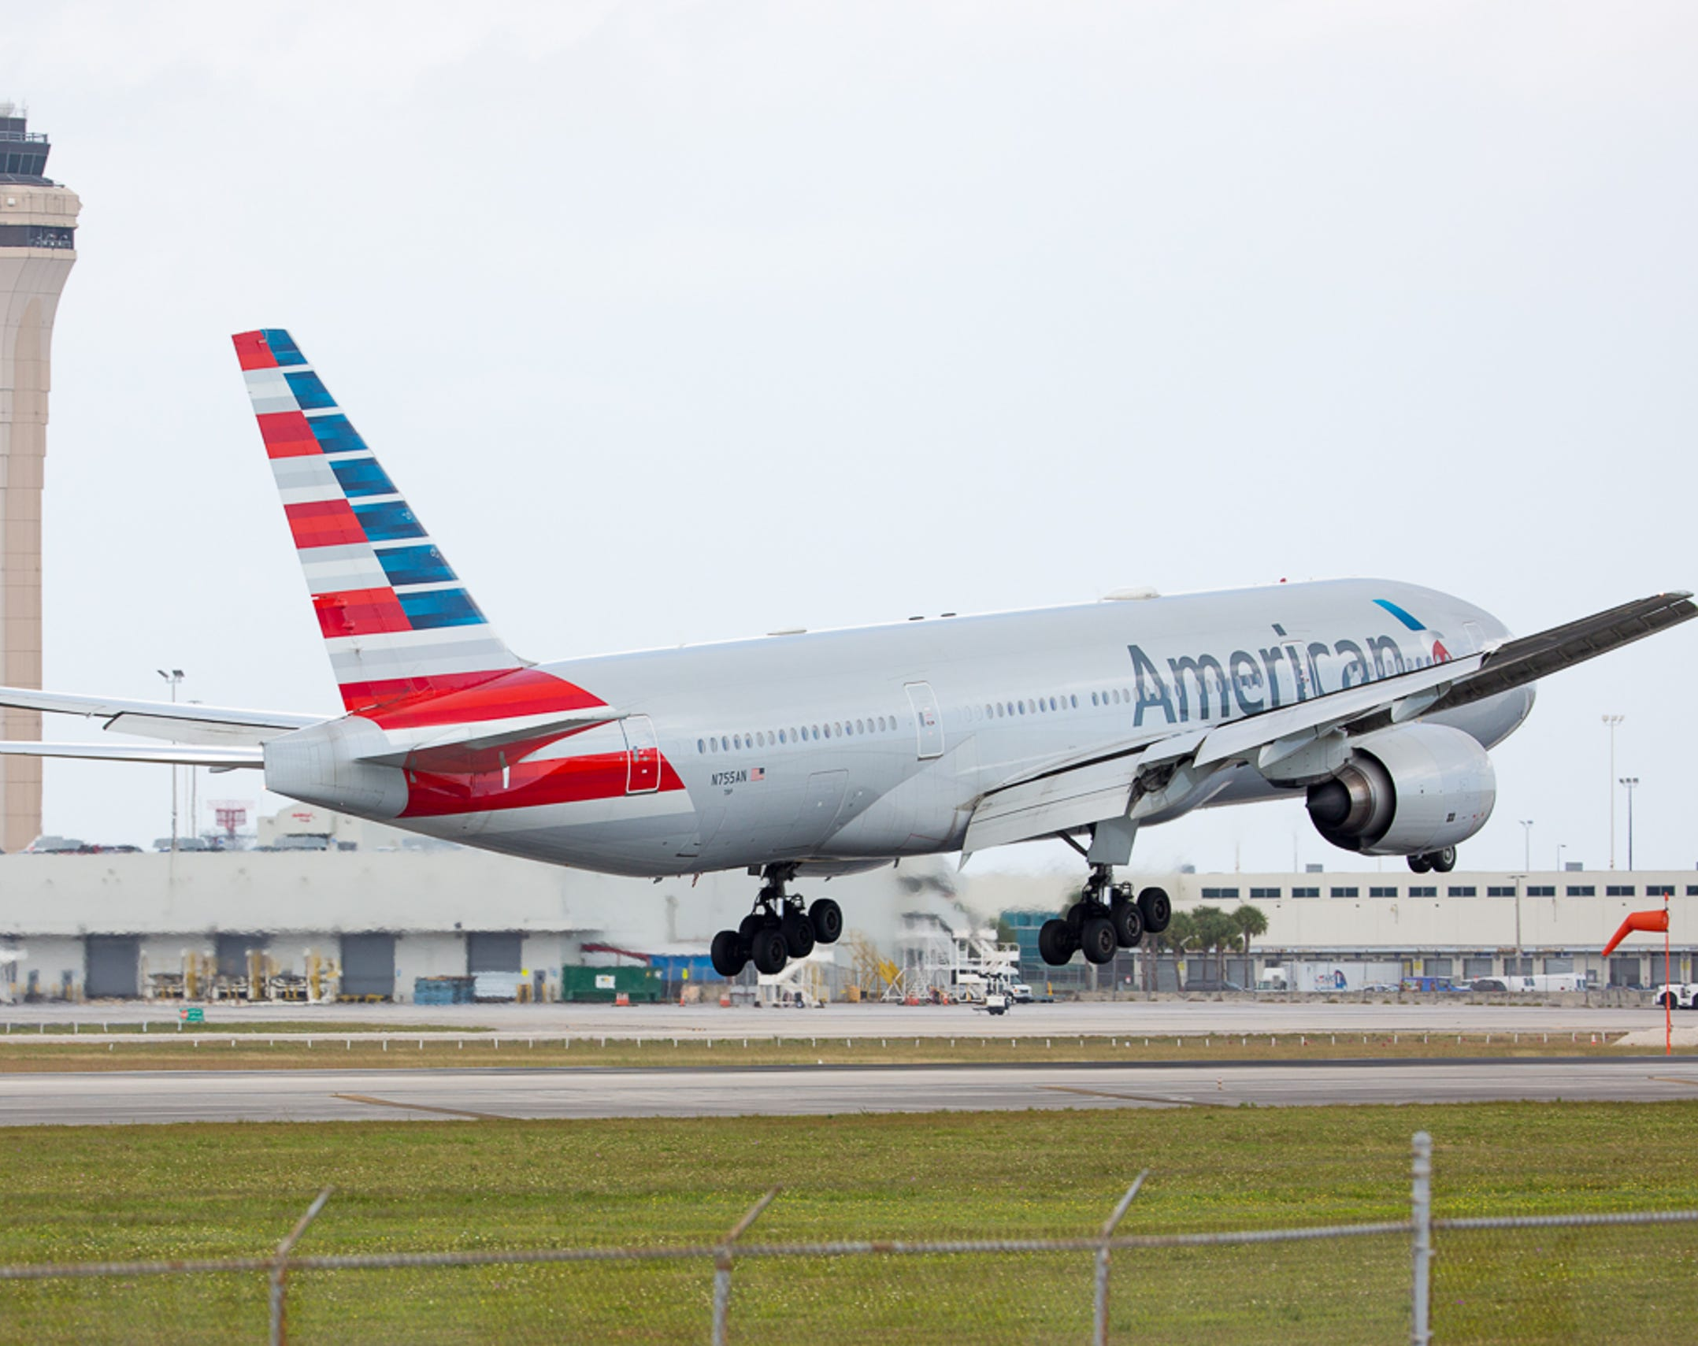
USA Flight Delay Analysis
Presenting... Abul Monsur Mannan

Slide 2
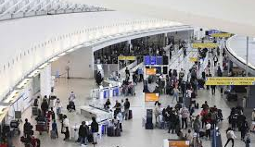
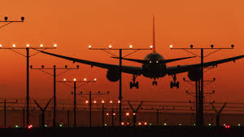
Agenda
Introduction
Goal and Findings
Challenges
Conclusion

Slide 3
Introduction
This presentation focuses on USA flight data encompassing the first 3 months of 2019, specifically addressing flight delays. These data are associated with airports, carriers, and plane information. An exploratory data analysis has been conducted on the flight dataset.

Slide 4
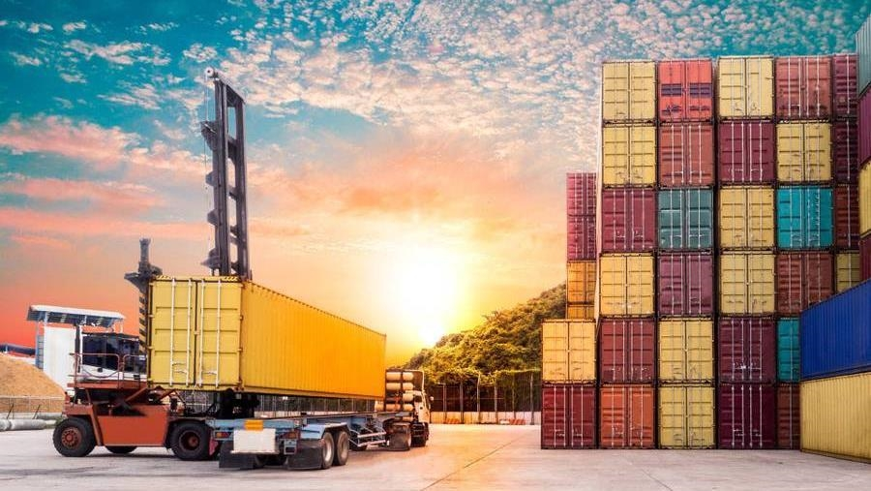
Goal & Findings

Slide 5
Goal
The focus of this analysis is to find out when and where the flight delays occurs and by which carriers. Also, we tried to find out the reason for those delays.

Slide 6
Focusing on arrival delays and departure delays
What is arrival and departure delay?
The general rule for arrival delay considers when a carrier arrives after 15 minutes of the scheduled arrival time. [1]

Slide 7
Some statistical insights into the datasets
Arrival delays:
About 3% of the 1.7 million arrival delay entries had no information.
1.88% of flights arrived exactly on schedule with no delays mentioned.
The highest delay recorded by a carrier is 2,649 in min (around 44 hrs delay)
The earliest arrival recorded by a carrier is 94 min
The average delay among all recorded arrival delays is 5.26 minutes.

Slide 8
Some statistical insights on the datasets
For Departure delays
No information was recorded for 2.5% (approx.) of the 1.7 million departure delay entries.
5% of flights departed exactly on schedule with no delays mentioned.
The highest delay recorded by a carrier is 2,672 in min (around 2 days delay)
The average delay among all recorded departure delays is 10.62 minutes.
3% of the data which has no information has been overlooked for the analysis as it has no significant value in the practical point of view.

Slide 9
More statistical insights:
In the flight cancellation category, 97.45% of flights were not cancelled
Diverted flights has similar entries
Cause of delays
Out of any entries:
Carrier delay: About 52% showed no delays related to carriers.
Weather delay: 6% recorded as weather-related delays
NAS delay: around 44% indicates no NAS delays
Security delay: around 0.3% indicates security delays
Late Aircraft delay: around 51% delays are related to late aircraft delays
We will go deep inside these delays in the coming analysis.

Slide 10
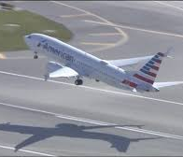
Correlation
Finding...

Slide 11
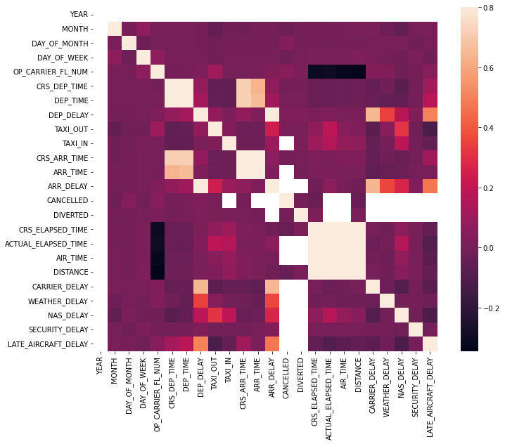
Correlation on flight delay dataset
The mathematical correlation indicates:
Arrival delays and departure delays could be related,
The delay types are related to flight cancellation and diversion data
The delay types are loosely related to arrival and departure delays
Heatmap shows correlation between the categories.

Slide 12
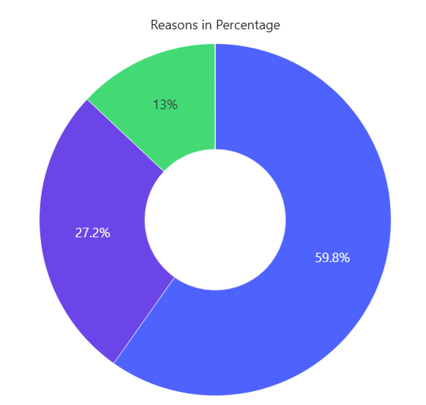

Reasons for Cancellation across the 3 months
B – Weather
A – Carrier
C- NAS
D - Security
Weather is the biggest reason for cancellation over the 3 months

Slide 13
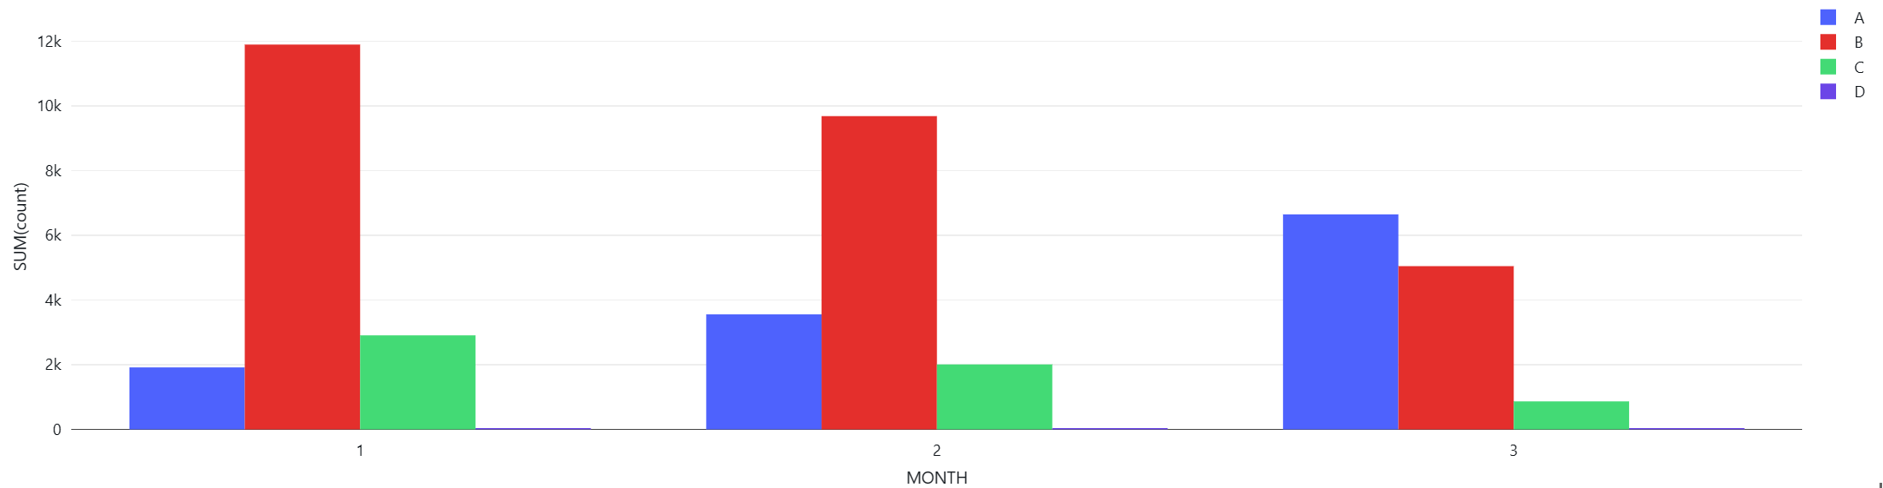
Reasons for Cancellation by Months
A - Carrier
B - Weather
C - NAS
D - Security
Major points here :
Weather is the biggest reason for cancellation for the first 2 months.
With the better weather, flight cancellation went down.
Cancellation reason of 'Carrier' was increasing and took the main reason in March
Security reason is negligible comparing with other reasons.

Slide 14
Delays...
All about arrival delays and departure delays

Slide 15
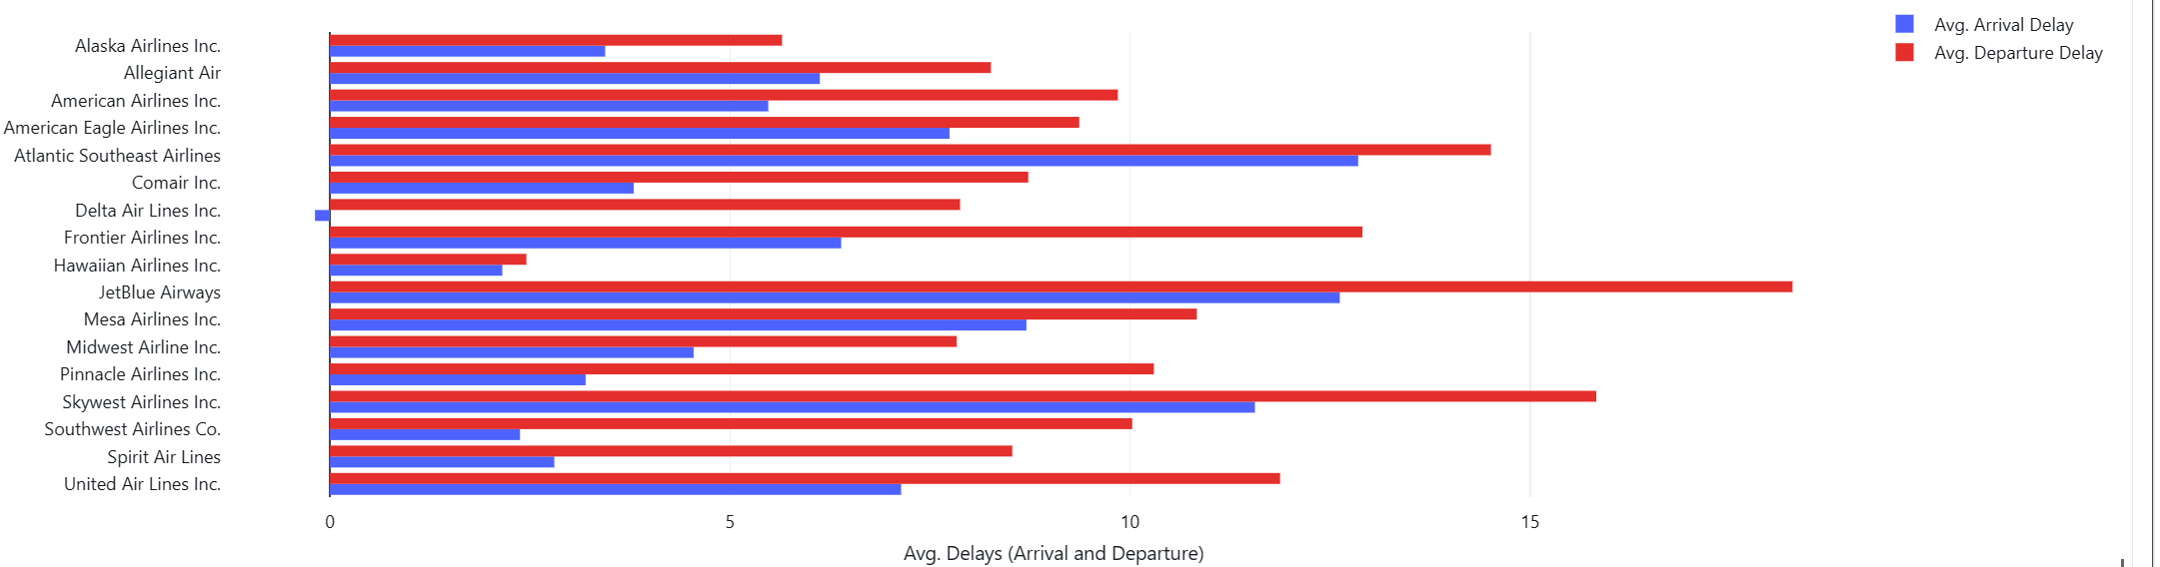
Average delays in departure delays and arrival delays by each carrier
There are total 17 distinct carriers in our dataset.​
Conclusion: Departure delays are always higher than arrival delays by any carriers across those 3 months.

Slide 16
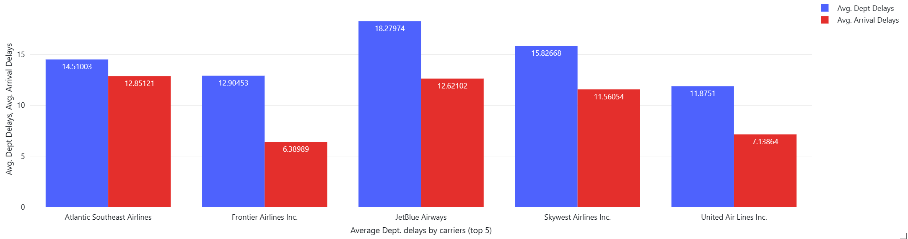
Highest average delays in departure delays and arrival delays by top 5 carriers (in minutes) across the 3 months
Conclusion: The Average departure delays by these carriers are more than 10 minutes ( on top of the 15 min threshold).

Slide 17
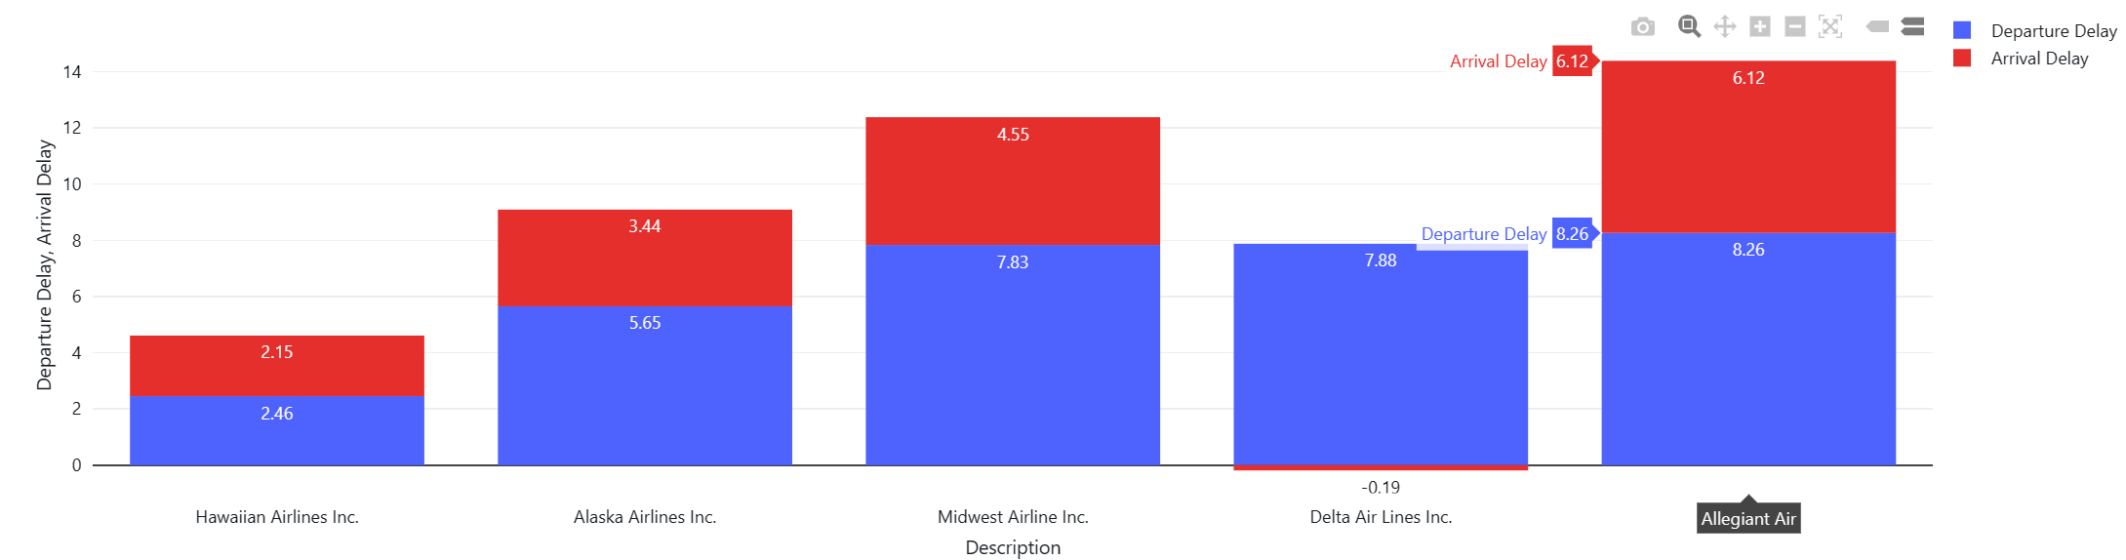
Lowest average delays in departure delays and arrival delays
Best 5 among 17 carriers

Slide 18
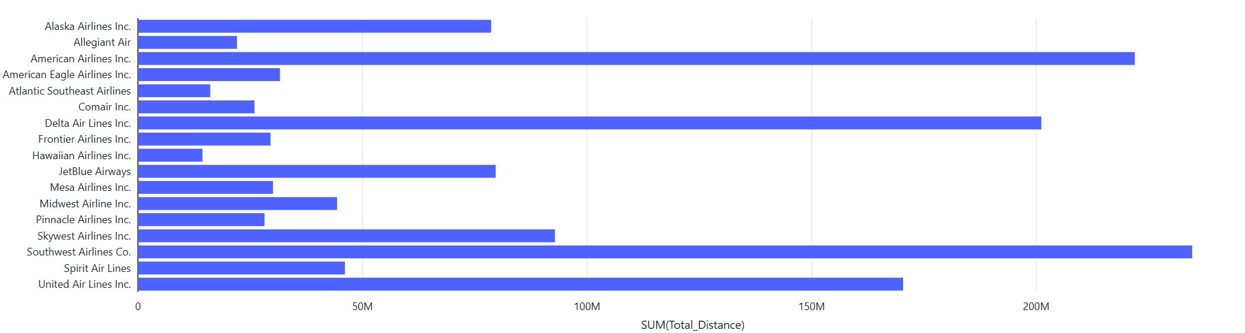
But, it is worth to see which carriers travelled most?
The top 4 busiest carriers are:
Southwest Airlines
American Airlines
Delta Air Lines
United Air Lines
Conclusion: In those 3 months, operation wise, Delta Air Lines shows better performance by keeping their delays lowest comparing other carriers.

Slide 19
Delays by days and months...

Slide 20
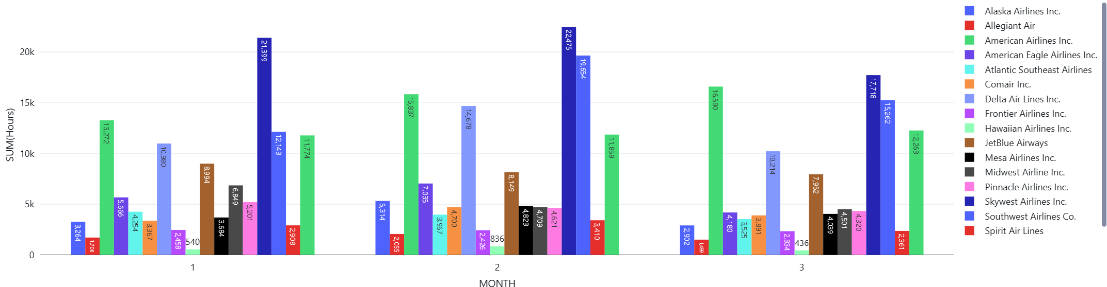
Arrival delays by month and in hours
Over those 3 months, Skywest, Southwest, American and United Air lines consistently shows highest delays.

Slide 21
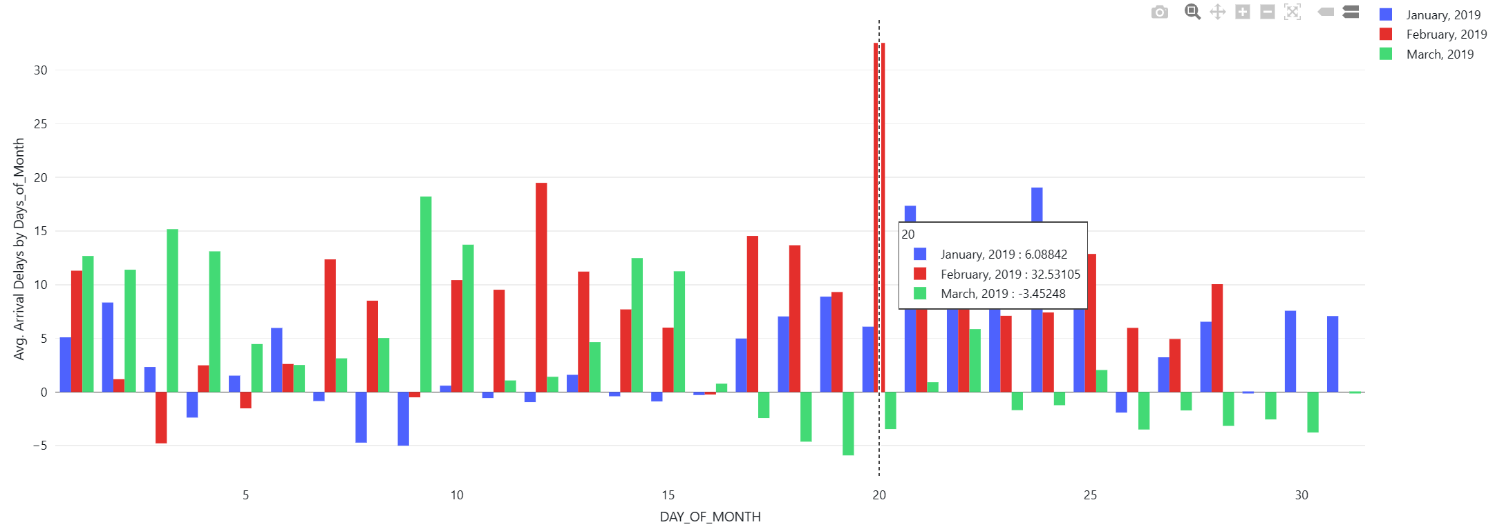
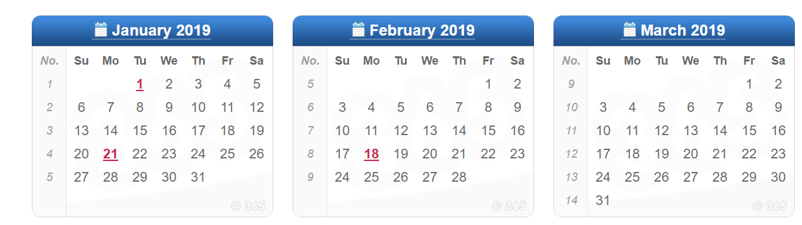
Average arrival delays by days of month and in hours
In terms of arrival delays:
Second-half of the January was worst,
All through the February was bad, and
Second half of the March shows better performances by the carriers
Weekdays and weekend flights does not matter much

Slide 22
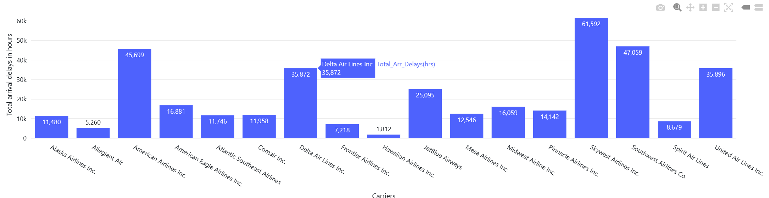
Another look: Total arrival delays over those 3 months by carriers

Slide 23
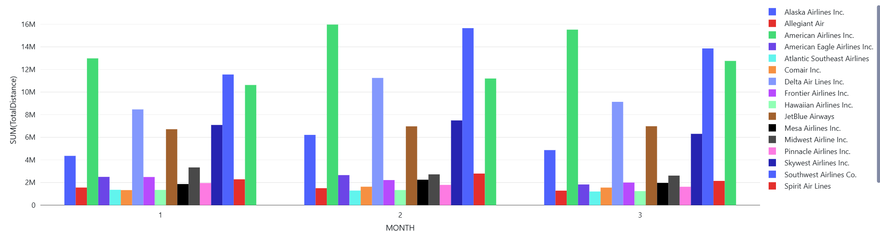
Total distance travelled by a carrier and by Month (filtering the cancelled flights)

Slide 24
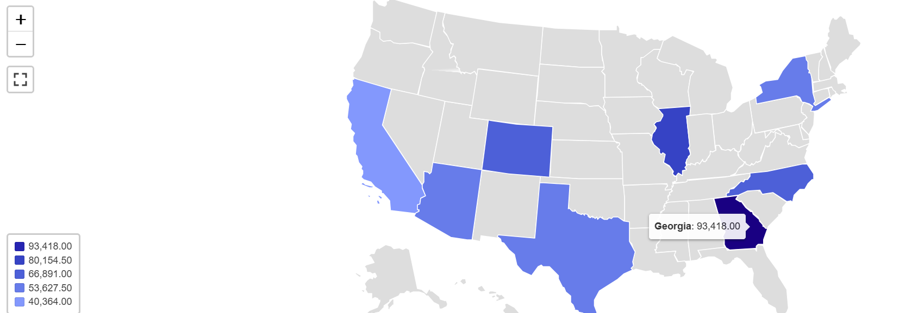
Busiest airports by ORIGIN
Airports play important role on flight management. The state Geogia was the busiest airport among all the state in terms of flights origin.

Slide 25
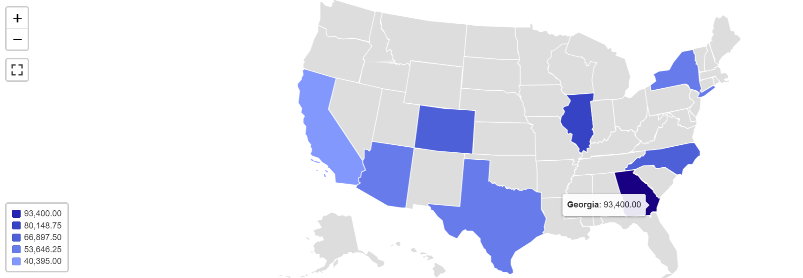
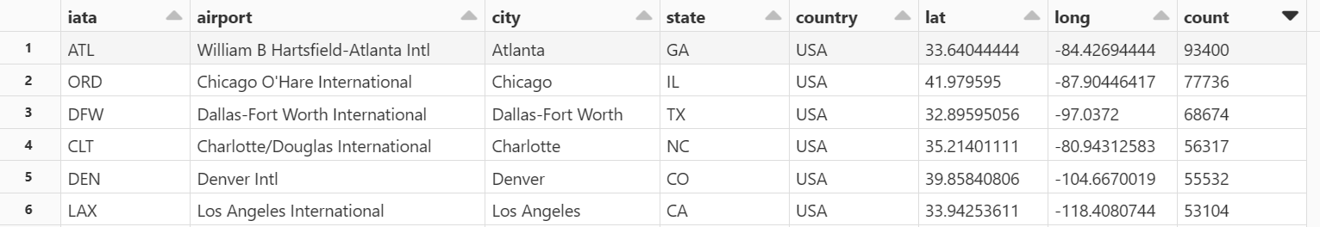
Busiest airport by destination
In those 3 months, William B Hartsfield of Atlanta city, Chicago O'Hare of Chicago and Dallas-Fort Worth of Dallas-Fort Worth were the busiest airports.
If possible, passengers could avoid flights from/to these airport in the first 3 months of 2019.

Slide 26
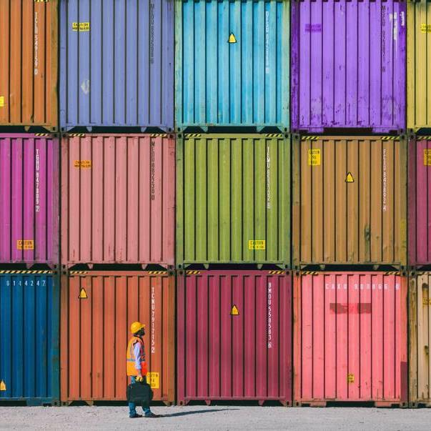

Challenges
No background knowledge about the USA aviation system
More relation could be stablished from the aircraft/ plane data available which is not used here
Time

Slide 27
References
https://www.oag.com/airline-on-time-performance-defining-late]

Slide 28
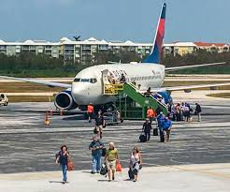
THANK YOU

